Slide 1
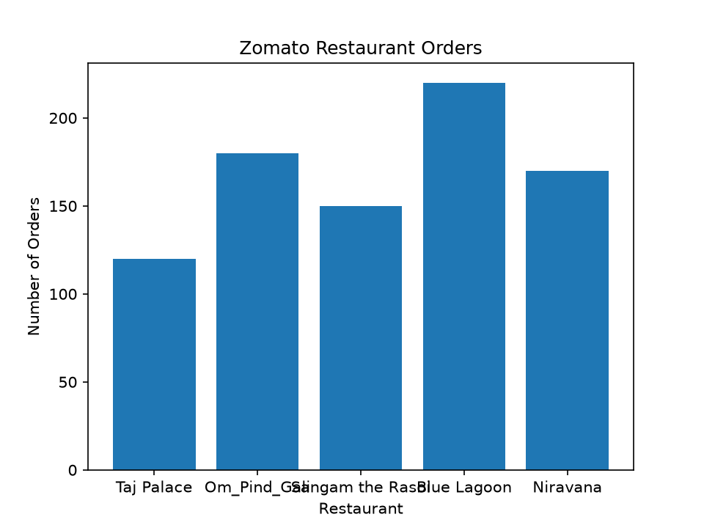
TASK 4 Embed Chart into PowerPoint

